Slide 1
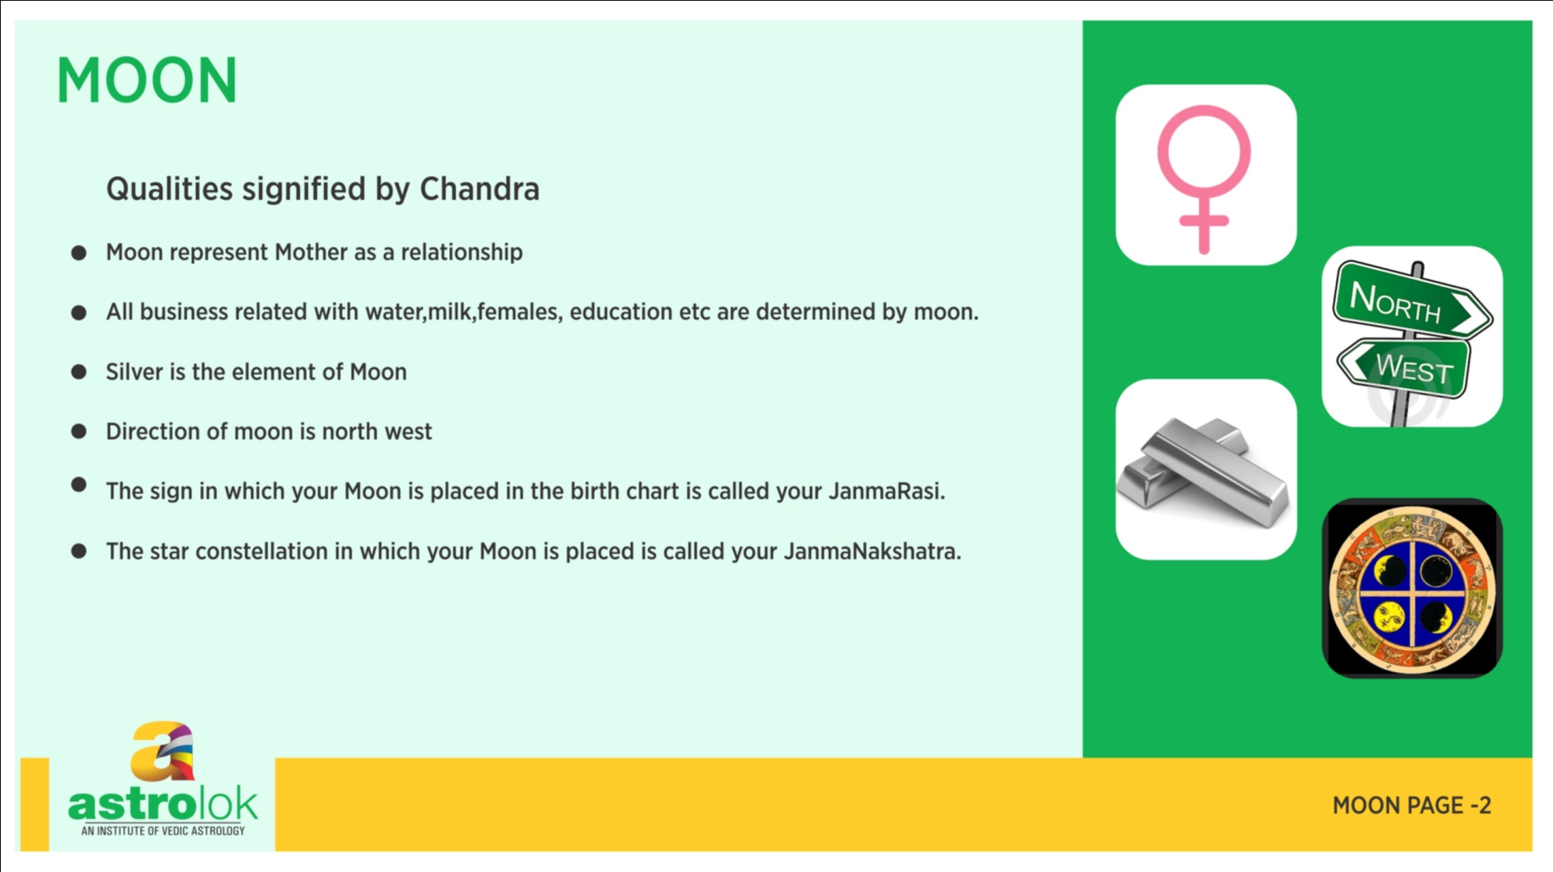

Slide 3
Moon in different houses 1st house
Mind Rule the body
Very moody and fickle minded
These people are attention seeking and concerned about
their personality
These people are wealthy and beautiful
Self centred

Slide 4
Moon in different houses 2nd house
Family oriented
Money minded and intelligent in financial matters
Wealthy and tendency to earn more
Fond of liquid food
Speak softly and babble sometimes

Slide 5
Moon in different houses 3rd house
These people ask so many questions but not able to execute
Has lot of dreams during early morning
Loves travelling
Speaks less
Posses some creative talent
Goes in trans very fast
Good observer

Slide 6
Moon in different houses 4th house
Not good since karkabhavnasham
Bad relationship with mother or will not care for mother
emotions
Loss of mother if very badly placed
Very fond of pleasure and opposite sex
Generally sad and disturbed sleep

Slide 7
Moon in different houses 5th house
They dream more about past life
Very emotional about kids
If moon is ill placed, deprived of kids
Good education sharp learner
Good sadhak loves mantra

Slide 8
Moon in different houses 6th house
Most disease are cause by their mind, not in reality
Trouble in relationship, especially with wife
Easily gets into negativity
Mental disorder

Slide 9
Moon in different houses 7th house
Good house for moon, their opposite partners are caring
Very wealthy
Caring and beautiful
Posses some creative talents

Slide 10
Moon in different houses 8th house
Baalrishta yoga, not good for health
Doubt always remain in the mind
Mental disorders
Closeness to in laws
Interested in research, mystics, tantra,mantra and astrology

Slide 11
Moon in different houses 9th house
Generally, have long journeys
Work related with navy or water
Spiritual in nature, loves to do religious deeds

Slide 12
Moon in different houses 10th house
Work or professions keep changing
Loves to work
They are good planers but poor executors
They imagine everything about work even before starting
Good for poets, song writers, story writers
Good for transport, creative jobs

Slide 13
Moon in different houses 11th house
They have more opposite gender friends then same gender
Their desire fulfilment is very powerful
They are always welcomes and desired by people
People friendly people

Slide 14
Moon in different houses 12th house
Not good for mental health, creates disorders
Easily gets into negativity
Spendthrifts
They will take advice from everyone but do what they want
Easily gets into depressions

Slide 15
If the moon is mesha the person will have properties, will have sons, defeated by females, devoid of good friends but will be very prosperous and famous.
If moon is in vrishabha the person will be cool,intelligent,will have good body,very competent, always happy, religious and will read scriptures.

Slide 16
If moon is in Gemini, the native will be loved by everyone, religious, loved by opposite gender, and will gain respect all over. He will be confuse and miser also.
If moon is in Karka the person will be proficient in scriptures, good in arts, soft hearted, will love swimming,flowers,and will fulfill his wishes easily.

Slide 17
If moon is in Leo the person will love travelling especially to hills and forest areas, will suffer from stomach problems and will be weak.
If moon is in kanya, the person will be very good in dealing with females, will have more female child and will be very good in human behavior and skillfull.

Slide 18
If moon is in Tula the person will be good in matter related to automobile, worship the brahmin and devatas,donor,will have multiple relationship and will increase his power by accumulating wealth
If moon is in vrashchika the person is ditched by his friends, will be interested in teaching and reading and will be unstable from mind.

Slide 19
If moon is in dhanu,the person will be intelligent and skillful. He will have weak body, will be soft by speech and will accumulate wealth. He can me a miser.
If moon is in the makar the person will be fearful with cold,will be fond of music, will have good aura, will have high libido and will be the richest in the family

Slide 20
If moon is in Kumbha, the native will be lazy, will be diligent, intelligent and will control his enemies.
If moon is in Meena the person will control his senses, intelligent and skillful, will love outing, and will be proficient in various arts. He will have a tendency of getting into emotions and will be competitive.

